Slide 1


Object-Oriented Programming
Presentation for use with the textbook Data Structures and Algorithms in Java, 6th edition, by M. T. Goodrich, R. Tamassia, and M. H. Goldwasser, Wiley, 2014

Slide 2
Goals, Principles and Patterns
2.1

Slide 3
Terminology
Each object created in a program is an instance of a class.
Each class presents to the outside world a concise and consistent view of the objects that are instances of this class, without going into too much unnecessary detail or giving others access to the inner workings of the objects.
The class definition typically specifies instance variables, also known as data members, that the object contains, as well as the methods, also known as member functions, that the object can execute.

Slide 4
Goals 1
Goals of Object-Oriented Design
Robustness
Adaptability
Reusability

Slide 5
Goals 2
Robustness
We want software to be capable of handling unexpected inputs that are not explicitly defined for its application.

Slide 6
Goals 3
Adaptability
Software needs to be able to evolve over time in response to changing conditions in its environment.

Slide 7
Goals 4
Reusability
The same code should be usable as a component of different systems in various applications.

Slide 8
Object-Oriented Design Principles
2.1.2

Slide 9
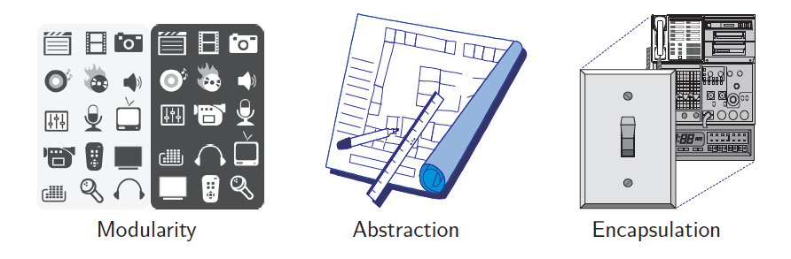
Object-Oriented Design Principles
Modularity
Abstraction
Encapsulation

Slide 10
Modularity
Parts of the software that are "coherent"
Module: Put components related to the same functionality together
Separate this module as much as possible from functions of other modules
Reuse a module: plug it in

Slide 11
Java Modularity: Class
The class is Java's base for modularity
Design classes carefully
Minimize interface with unrelated classes
Maximize coherence within a class

Slide 12
Abstraction
Different classes can perform similar functions differently
Abstract the similarities
Carefully define what's in common
Use inheritance and interfaces
Hide the differences and details

Slide 13
Abstract Data Types
Abstraction is to distill a system to its most fundamental parts.
Applying the abstraction paradigm to the design of data structures gives rise to abstract data types (ADTs).
An ADT is a model of a data structure that specifies the type of data stored, the operations supported on them, and the types of parameters of the operations.
An ADT specifies what each operation does, but not how it does it.
The collective set of behaviors supported by an ADT is its public interface.

Slide 14
Encapsulation
Advertise to the world what your class does
public keyword
Hide how your class does it
private
Public interface/private implementation

Slide 15
Encapsulation
Counter class!
For all your counter needs!
Back room implementation:
private int value;
Public methods available:
int getValue()
click()
reset()

Slide 16
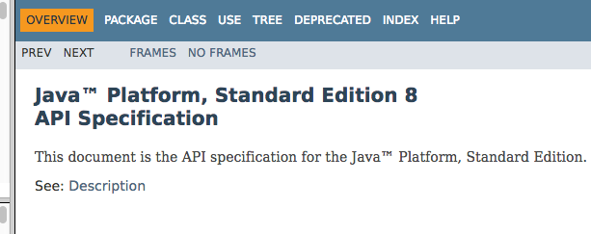
Java Documentation
Application Programmer Interface (API)
https://docs.oracle.com/javase/8/docs/api/index.html

Slide 17
Design Patterns
2.1.3

Slide 18

Design Patterns
Algorithmic patterns:
Recursion
Amortization
Divide-and-conquer
Prune-and-search
Brute force
Dynamic programming
The greedy method
Software design patterns:
Iterator
Adapter
Position
Composition
Template method
Locator
Factory method

Slide 19
Object-Oriented Software Design
Responsibilities: Divide the work into different actors, each with a different responsibility.
Independence: Define the work for each class to be as independent from other classes as possible.
Behaviors: Define the behaviors for each class carefully and precisely, so that the consequences of each action performed by a class will be well understood by other classes that interact with it.

Slide 20
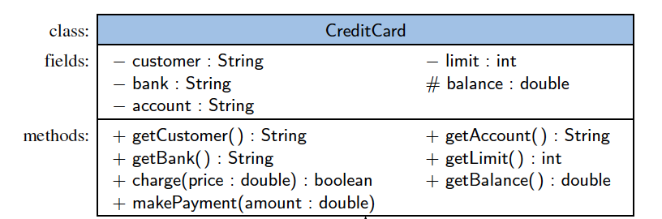
Unified Modeling Language (UML)
A class diagram has three portions.
The name of the class
The recommended instance variables
The recommended methods of the class.

Slide 21
Class Definitions 1
A class serves as the primary means for abstraction in object-oriented programming.
In Java, every variable is either a base type or is a reference to an instance of some class.

Slide 22
Class Definitions 2
A class provides a set of behaviors in the form of member functions (also known as methods), with implementations that belong to all its instances.
A class also serves as a blueprint for its instances, effectively determining the way that state information for each instance is represented in the form of attributes (also known as fields, instance variables, or data members).

Slide 23
Constructors
A user can create an instance of a class by using the new operator with a method that has the same name as the class.
Such a method, known as a constructor, has as its responsibility is to establish the state of a newly object with appropriate initial values for its instance variables.

Slide 24
Inheritance
2.2

Slide 25
Inheritance 1
A mechanism for a modular and hierarchical organization is inheritance.
This allows a new class to be defined based upon an existing class as the starting point.

Slide 26
Inheritance 2
The existing class is typically described as the base class, parent class, or superclass, while the newly defined class is known as the subclass or child class.
There are two ways in which a subclass can differentiate itself from its superclass:
A subclass may specialize an existing behavior by providing a new implementation that overrides an existing method.
A subclass may also extend its superclass by providing brand new methods.

Slide 27
Inheritance

Slide 28
Inheritance Hierarchies
Super!
Base class
General
Sub.
Specific
Subclass

Slide 29
Java Inheritance
The word in Java for "inherits from" is extends.
Java classes can only inherit from one parent class

Slide 30
Subclass Declaration Syntax
Instance variables added to the subclass
public class ChoiceQuestion
extends Question
{
private ArrayList<String> choices;
public void addChoice(
String choice,
boolean correct) { . . .}
public void display() { . . . }
}
Methods that are added to the subclass
Methods that the subclass overrides

Slide 31
Inheritance
American
Base class
General
“IS-A”
Californian
Specific
Subclass

Slide 32
Inheritance and Constructors 1
Constructors are never inherited in Java; hence, every class must define a constructor for itself.
All of its fields must be properly initialized, including any inherited fields.
There are some rules ...

Slide 33
Inheritance and Constructors 2
The first operation within the body of a constructor must be to invoke a constructor of the superclass, which initializes the fields defined in the superclass.
Truck extends Vehicle { Truck() {super();}
}

Slide 34
Inheritance and Constructors 3
A constructor of the superclass is invoked explicitly by using the keyword super with appropriate parameters.
If a constructor for a subclass does not make an explicit call to super or this as its first command, then an implicit call to super( ), the zero-parameter version of the superclass constructor, will be made.

